Slide 1
Thetchinamoorthy V
B.TECH AI&DS-III YEAR
SINCET
NM ID:au821721243055

Slide 2
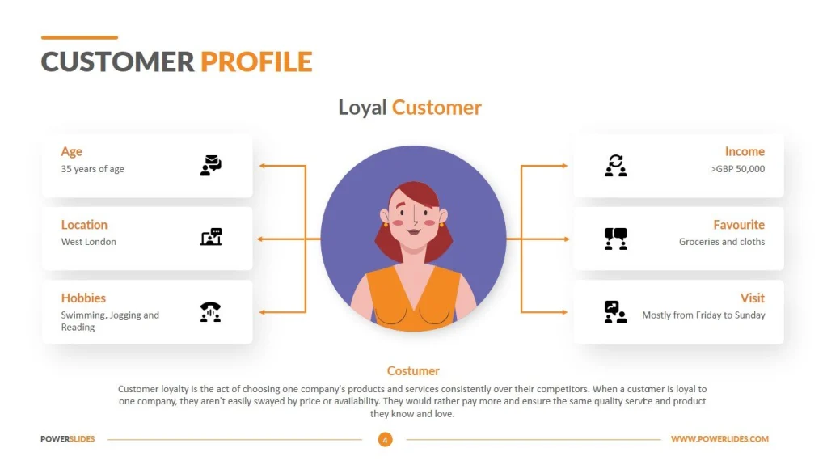
USER PROFILING

Slide 3

AGENDA
1. Data Collection:
Identify the sources of data: website analytics, app usage data, customer surveys, social media, etc.
Decide on the types of data to collect: demographic information, behavior patterns, preferences, etc
2.Data Processing and Integration:
Clean and preprocess the collected data to handle missing values, outliers, and inconsistencies.
Integrate data from multiple sources to create comprehensive user profiles.
Use data transformation techniques like normalization or feature scaling as needed.
3.Feature Selection and Engineering:
Identify relevant features for user profiling based on the defined objectives.
Conduct exploratory data analysis (EDA) to gain insights into the data and identify potential features.
Engineer new features if necessary to capture specific user behaviors or characteristics.
4.User Profile Creation:
Generate user profiles based on the output of the modeling and analysis phase.
Define attributes and characteristics for each user profile, such as demographics, interests, purchase history, etc.
Ensure that user profiles are actionable and useful for personalized marketing or product recommendations.
5.Validation and Iteration:
Validate user profiles by comparing them with ground truth data or conducting user surveys.
Iterate on the modeling and analysis process based on feedback and new data.
6.Implementation and Deployment:
Monitor the performance of user profiling systems and make adjustments as needed.

Slide 4

PROBLEM STATEMENT
Description:
Create user profiles from diverse data sources to deliver personalized recommendations for products, content, or services. Segment users based on demographics and behavior, model user preferences, and develop a recommendation engine integrated with user profiles.
Objectives:
Collect data from various sources.
Segment users based on demographics and behavior.
Model user preferences and interests.
Deliver personalized recommendations.
Validate and evaluate recommendation system.
Deliverables:
Detailed user profiling system.
Personalized recommendation engine.
Documentation and presentation of findings.
Benefits:
Enhanced user engagement and satisfaction.
Increased conversion rates and revenue.
Improved customer loyalty and retention.

Slide 5

PROJECT OVERVIEW
Objective:
The objective of this user profiling project is to analyze and understand user behavior, preferences, and characteristics in order to create detailed user profiles. These profiles will serve as a foundation for delivering personalized experiences, recommendations, and targeted marketing strategies. By segmenting users based on their demographics, behavior patterns, and interests, the project aims to enhance user engagement, satisfaction, and loyalty.
Expected Outcome:
The expected outcome of this user profiling project is the creation of comprehensive and actionable user profiles that provide valuable insights into user demographics, preferences, and behaviors. These profiles will enable businesses to tailor their products, services, and marketing efforts to better meet the needs and preferences of their target audience. Ultimately, the project aims to improve user engagement, conversion rates, and customer retention by delivering personalized experiences that resonate with individual users.

Slide 6
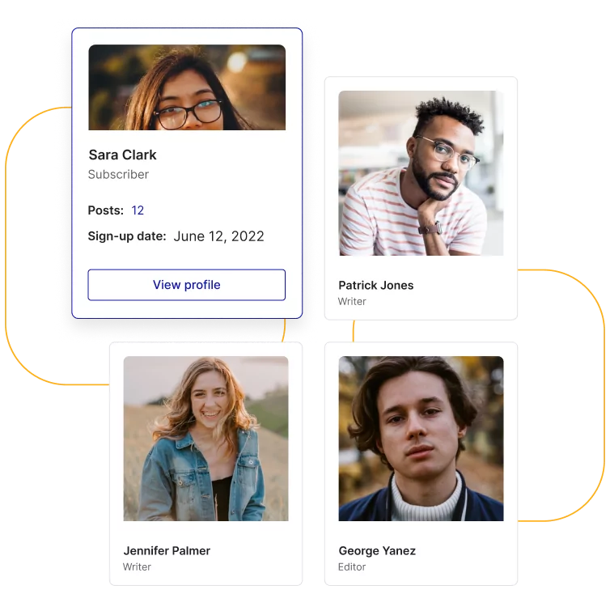

WHO ARE THE END USERS?
Marketing Teams
Product Managers
Sales Teams
Customer Support Teams
Business Analysts
Executives and Decision Makers
UX/UI Designers
Content Creators

Slide 7
YOUR SOLUTION AND ITS VALUE PROPOSITION
Personalization: Offer personalized experiences based on the collected data. This could include tailored recommendations, customized content, or targeted advertising.
Data Collection and Analysis: Develop methods for collecting user data, such as demographics, behavior patterns, preferences, and interactions. Use machine learning and data analytics to process this information effectively.
Privacy and Security: Ensure robust privacy measures to protect user data. Implement encryption, anonymization, and permission-based access controls to build trust with users.
Value Proposition:
Accuracy: Highlight the accuracy and relevance of the user profiles generated by your solution. This ensures that businesses can make informed decisions based on reliable data
Efficiency: Emphasize the efficiency gains for businesses in understanding their customers better. By automating the profiling process, your solution saves time and resources.
FeedbackLoop: Establish a feedback mechanism to continuously improve your profiling algorithms and enhance

Slide 8
THE WOW IN YOUR SOLUTION
1.AI-Driven Predictive Analytics: Implement advanced AI algorithms that not only analyze past user behavior but also predict future actions and preferences with remarkable accuracy. This proactive approach enables businesses to anticipate user needs and stay ahead of the competition.
2.Augmented Reality (AR) User Profiling: Integrate AR technology to create immersive user profiling experiences. Allow businesses to visualize user data in real-world contexts, gaining deeper insights and enhancing decision-making processes.
3.Virtual Assistant Integration: Integrate your user profiling solution with popular virtual assistant platforms like Siri, Alexa, or Google Assistant. Empower businesses to leverage conversational AI for personalized interactions with users, creating seamless and intuitive experiences.
4.Biometric Authentication and Profiling: Integrate biometric authentication methods such as fingerprint or facial recognition to enhance user profiling accuracy and security. Enable seamless authentication experiences across devices while capturing valuable biometric data for profiling purposes.
8

Slide 9
MODELLING
1.Data Collection and Understanding:
Gather diverse data types including demographic information, browsing history, purchase behavior, social media activity, and any other relevant user interactions.
2.Model Selection:
Choose appropriate modeling techniques based on the nature of the problem and available data:
Classification Models: For predicting user attributes or segmenting users into different categories (e.g., age groups, interests).
Clustering Algorithms: For grouping users based on similarities in their profiles or behavior patterns.
Recommendation Systems: For suggesting personalized content, products, or actions based on user preferences.
Sequential Models: For capturing temporal dependencies in user interactions and predicting future behavior sequences.
Anomaly Detection Models: For identifying unusual or anomalous user activities that may indicate security threats or fraudulent behavior.
3.Model Deployment and Integration:
Deploy trained models into production environments using scalable and efficient infrastructure.
9

Slide 10
RESULTS
Without actual data, it's challenging to provide specific results for user profiling. However, I can outline the potential outcomes and insights you might expect from implementing a user profiling system:
1.User Segmentation: By analyzing user data, your profiling system can identify distinct segments or groups of users with similar characteristics or behaviors.
2.Persona Creation: Based on the segmented user groups, your system can generate personas that represent typical users within each segment.
3. Fraud Detection and Security: User profiling can also be used for fraud detection and security purposes. By monitoring user behavior for anomalies or suspicious patterns, your system can detect potential security threats, identity theft, or fraudulent activities in real-time, helping businesses mitigate risks and protect user data.
Demo Link
10

